Slide 1
CLERK
Computer Science Senior Capstone | MATES C/O 2026

Slide 2









THE CREATORS
MICHAEL THOMAS
JOHN SEDORIOSA
CHRIS NOLAN
Lead Coder / Full-Stack Architecting the multi-stage pipeline and logic feedback loops.
Backend Specialist Managing SQLite databases, FastAPI integrations, and API normalization.
Frontend Specialist Designing the React-based user interface for schedule visualization.

Slide 3

The PROBLEM
Our daily lives generate vast amounts of unstructured data, voice notes, emails, and quick texts, that get lost because they require manual effort to organize
Fragmented notes/tasks on various formats
Users must manually set reminders and cross-reference availability
Traditional calendars don’t learn user preferences or habit patterns

Slide 4
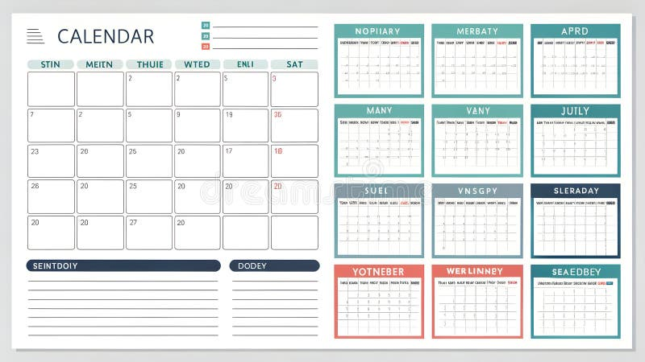
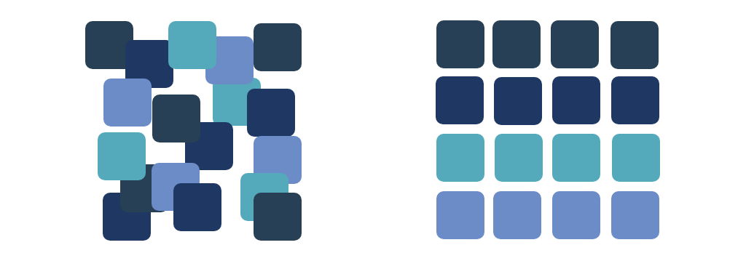
OUR SOLUTION: CLERK
A SEAMLESS PIPELINE
Clerk uses a multi-stage pipeline with feedback loops to process raw data.
•
Ingestion: Text and Audio
•
Normalization: Converting all messy inputs into plain text.
•
Intelligence: GPT-4o Mini extracts actionable JSON objects.

Slide 5






CORE INTELLIGENCE
TEMPORAL RESOLUTION
CONFIDENCE SCORING
ADAPTIVE BEHAVIOR
Resolves relative phrases like "tomorrow" or "by next Tuesday" into hard date-time stamps using current user context.
Calculates certainty based on language clarity. Vague items are flagged as "Inferred" for user review rather than guessed.
Uses statistical aggregation to learn user habits—like when you prefer to work—to improve future schedule suggestions.

Slide 6


WHY IT MATTERS
Automates translating notes and voice notes into calendar events
Learns user behavior and adapts to it, giving time to the user to focus on more important tasks
Manual scheduling is prone to human error
Clerk acts as a layer of verification ensuring user’s schedule is accurate
Saves mental energy

Slide 7


TECHNICAL INFRASTRUCTURE
BACKEND & APIS
FRONTEND & DEVOPS
•
Languages: Python, SQL
•
Web: React, HTML5, CSS3
•
Framework: FastAPI, Pydantic
•
Deployment: Render
•
Intelligence: GPT-4o Mini, Whisper
•
Tools: VS Code, GitHub
•
Database: SQLite
•
Integrations: Gmail, Google Calendar

Slide 8
ROAD MAP
01: Foundation
02: Extraction
03: Logic
FastAPI setup, SQL Schema design, and environment initialization.
Text paste interface, AI extraction layer with GPT-4o mini.
Confidence scoring system and converting relative phrases
04: Scheduling
05: Audio
06: Refinement
Order tasks by urgency and identify available time slots, build dashboard to view, edit, and approve suggestions .
OpenAI whisper for audio note transcription and Media Recorder API for browser based recording .
Implement light statistical aggregation to learn user behavior, and attempt Google Calendar API integration.

Slide 9
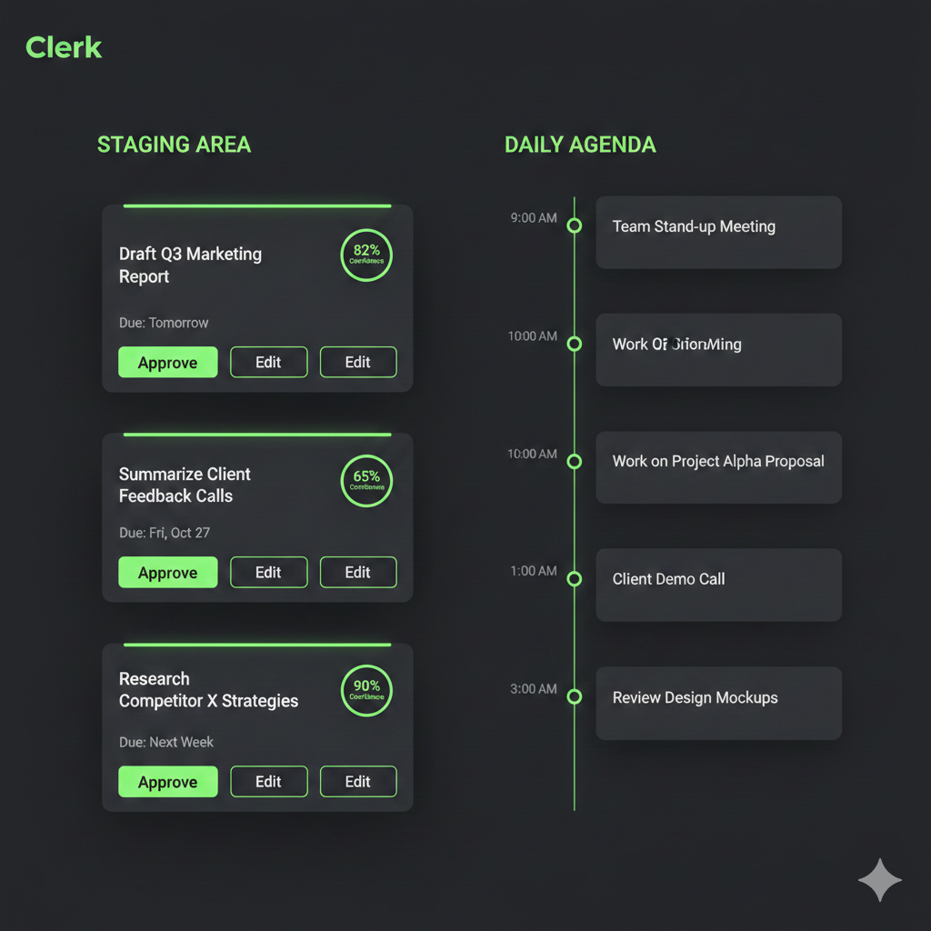
AI Image of what the Daily Agenda could look like

Slide 10
PROJECT BOUNDARIES
IN SCOPE
OUT OF SCOPE
Processing direct text inputs, emails, and audio files
Using GPT-4o Mini to transform unstructured data into actionable JSON schemas
Confidence based scoring system
Web based UI for task approval and scheduling
Fully autonomous scheduling without user review
Negotiating meetings between user’s calendars
Interactive Grid Calendar
Push notifications

Slide 11
FEEDBACK?
Thank you for your attention.

